Slide 1
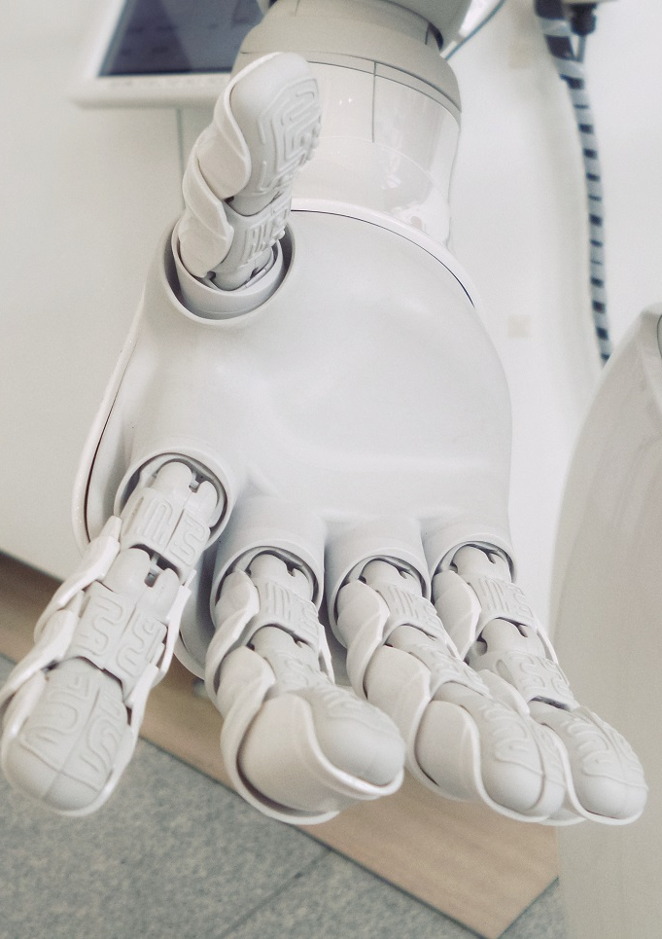

AI for Small Businesses
Mohammad Esmalifalak, PhD

Slide 2

1
Predictive Maintenance
in Data Centers

Slide 3
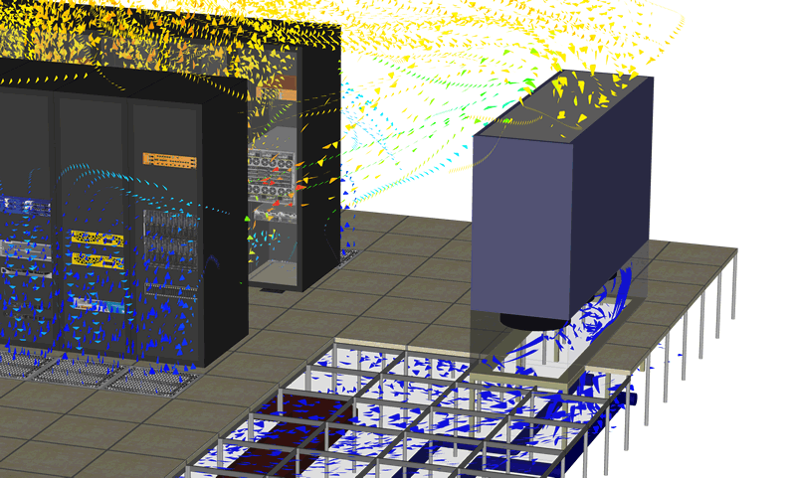
Data Center Operation
Cooling unit
(CRAC)
IT Racks

Slide 4
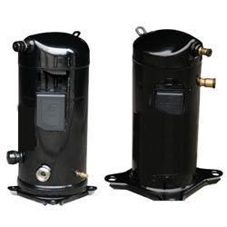
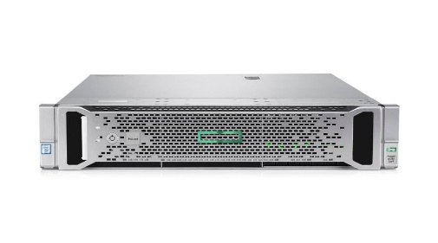
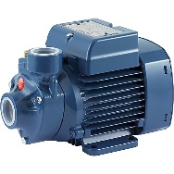
Data Center Operation
Condenser
Fan
Compressor
Condenser
Air Handler
Server Rack
Tank
Evaporator
Expansion
Valve
Fan
Pump

Slide 5
Statistical Anomaly Detection
Anomaly detection:
S2
x
S1
S1 Normal Range
x
S2 Normal Range
x
S2
S1 Normal Range
S1
Is this normal operation?
S1 Normal Range

Slide 6
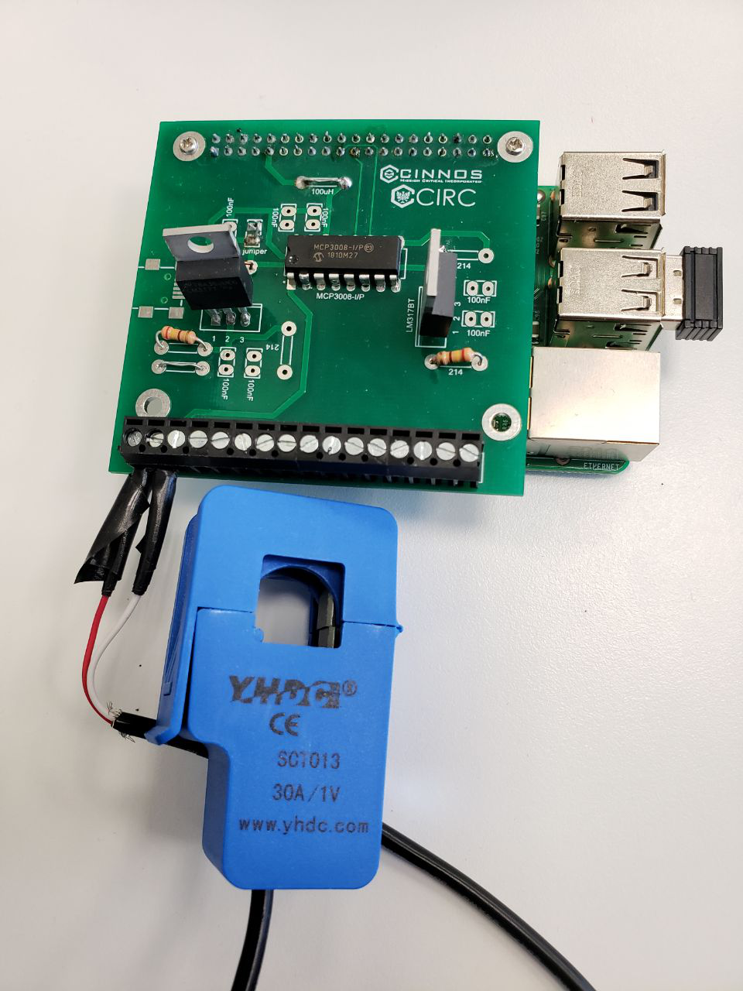
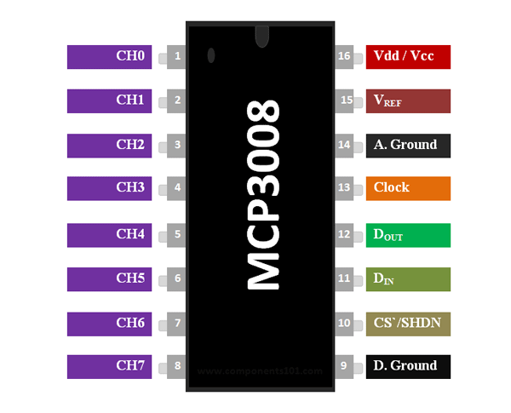
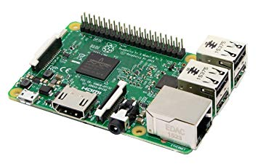
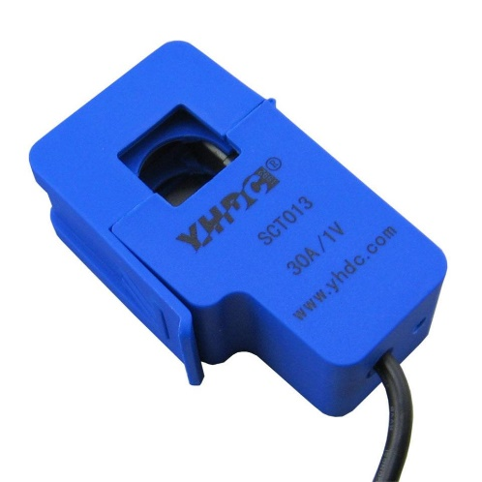
Data Acquisition System
Analogue to Digital Converter (ADC)
Positive input signals
Vref: for resolution
Vdd: to supply ADC
Current Transformer (CT)
Output can be + or –
Non invasive sensors
Raspberry Pi
Store Data (Database)
Communicate data
Train predictive models (Based on past obs.)
Make prediction (for new data)

Slide 7
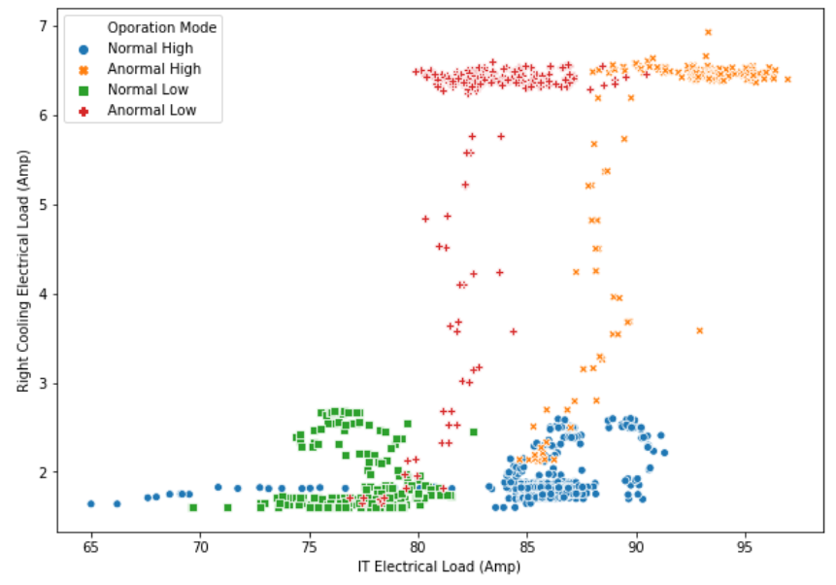
Data Center Operation
Most of cooling system failures can be detected in electrical domain
Server draw more current with the cooling failure (their fan speed goes …)
Cooling system fails and
temperature goes up
Fan speed goes up for almost the same amount of IT load

Slide 8
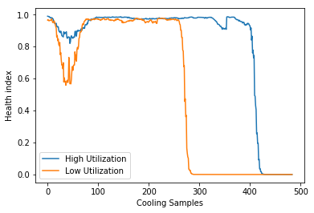
Data Center Operation
Data center starting
Pump Failure

Slide 9
Unsupervised Learning
What if we don’t know the labels?

Slide 10
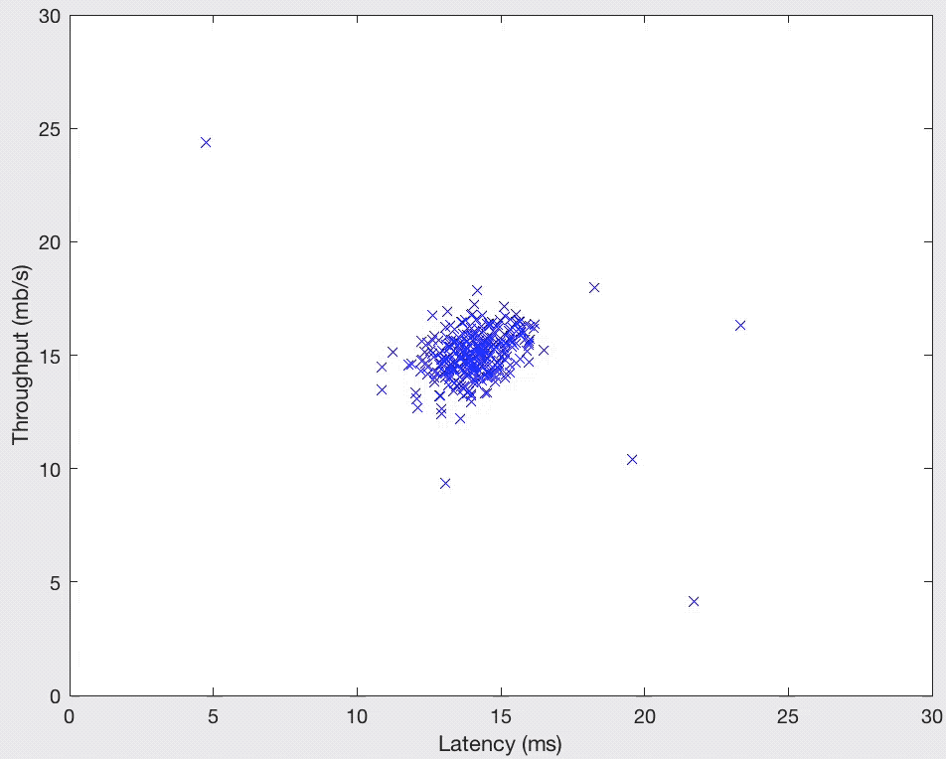
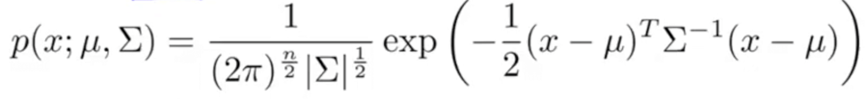
Anomaly Detection
Distance based (Statistical):
Future
Historical

Slide 11
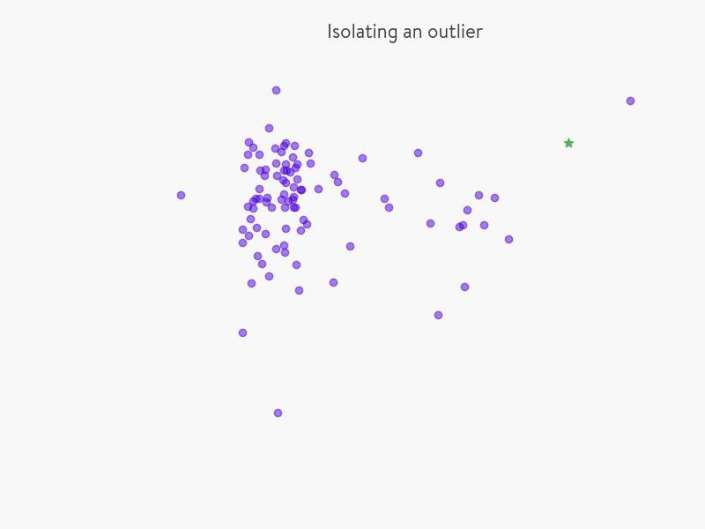
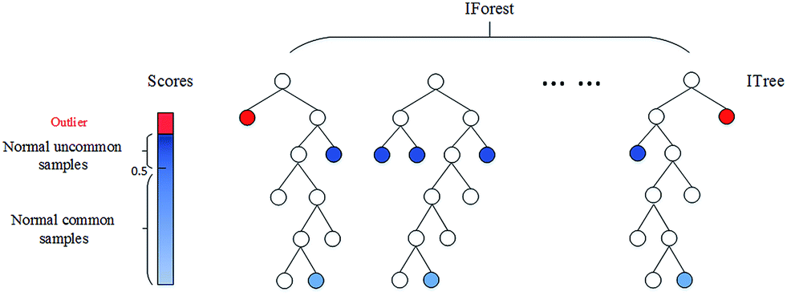
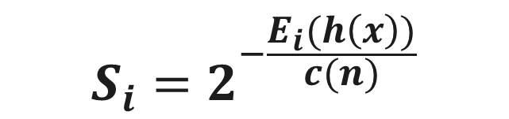
Anomaly Detection
Isolation forest (tree based):
Anomaly Score,
$$S_{i}=2^{−\frac{E_{i}(h\left(x\right))}{c(n)}}$$
Inliers: S → 0
Outliers: S → 1

Slide 12
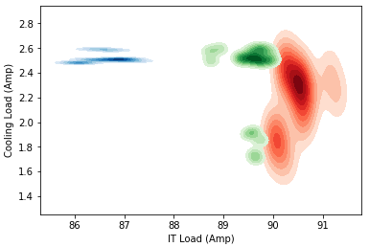
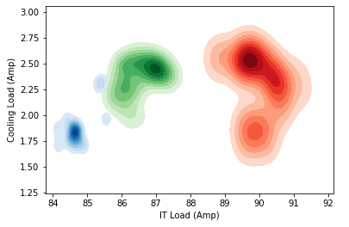
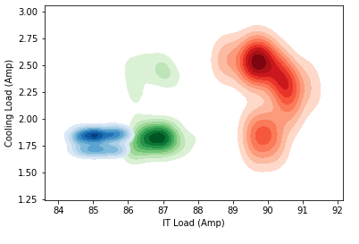
Kmeans-Evolution over time
First 100 samples
First 200 samples
First 300 samples
Evolution of clusters over time

Slide 13
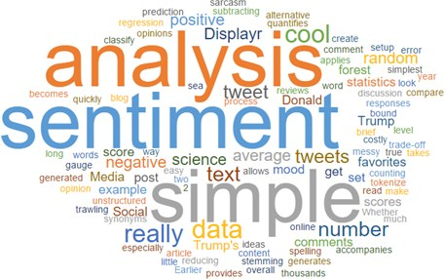
2
Sentiment Analysis

Slide 14
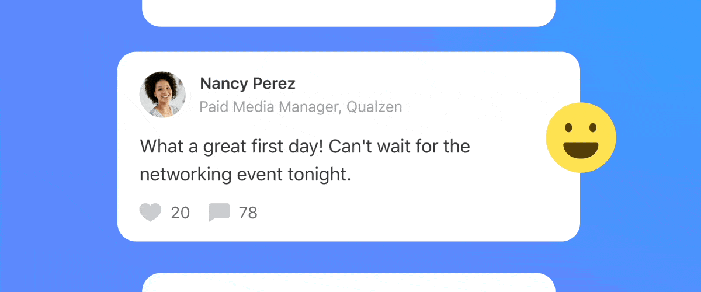
Sentiment Analysis
Event A
Vs
Event B

Slide 15
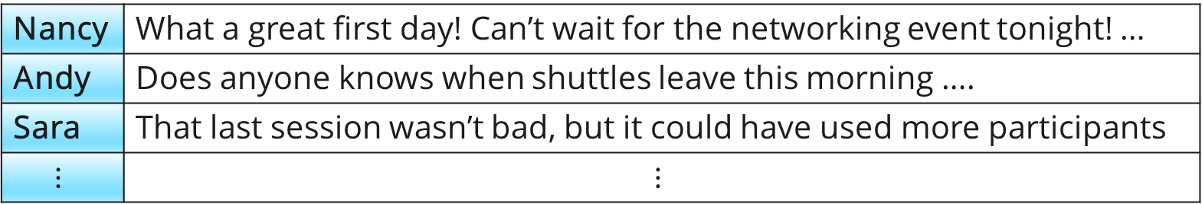
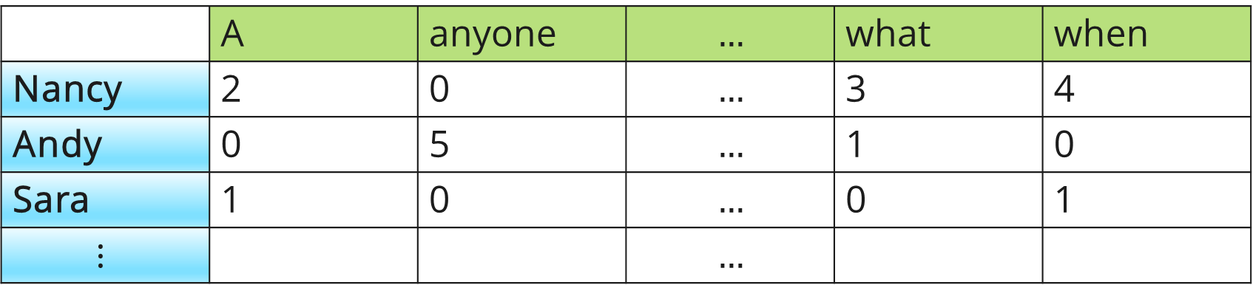
Sentiment Analysis
Corpus:
Nancy | What a great first day! Can’t wait for the networking event tonight! …
Andy | Does anyone knows when shuttles leave this morning ….
Sara | That last session wasn’t bad, but it could have used more participants
$$⋮$$ | $$⋮$$
~7000 common words
 | A | anyone | $$…$$ | what | when
Nancy | 2 | 0 | $$…$$ | 3 | 4
Andy | 0 | 5 | $$…$$ | 1 | 0
Sara | 1 | 0 | $$…$$ | 0 | 1
$$⋮$$ |  |  | $$…$$
Document term matrix:

Slide 16
Sentiment Analysis
Q: Sentiment analysis input:
Corpus or document term matrix?
A: Corpus because order matters! (Exercise is good but smoking is not good)

Slide 17
TextBlob Sentiment
from textblob import TextBlob
TextBlob(“I love biking”).sentiment
Sentiment(polarity=0.5, subjectivity=0.6)
-1 Polarity 1
0 Subjectivity 1
Negative Positive
Objective (Fact) Subjective (Opinion)
Notes:
https://github.com/sloria/TextBlob/blob/eb08c120d364e908646731d60b4e4c6c1712ff63/textblob/en/en-sentiment.xml

Slide 18
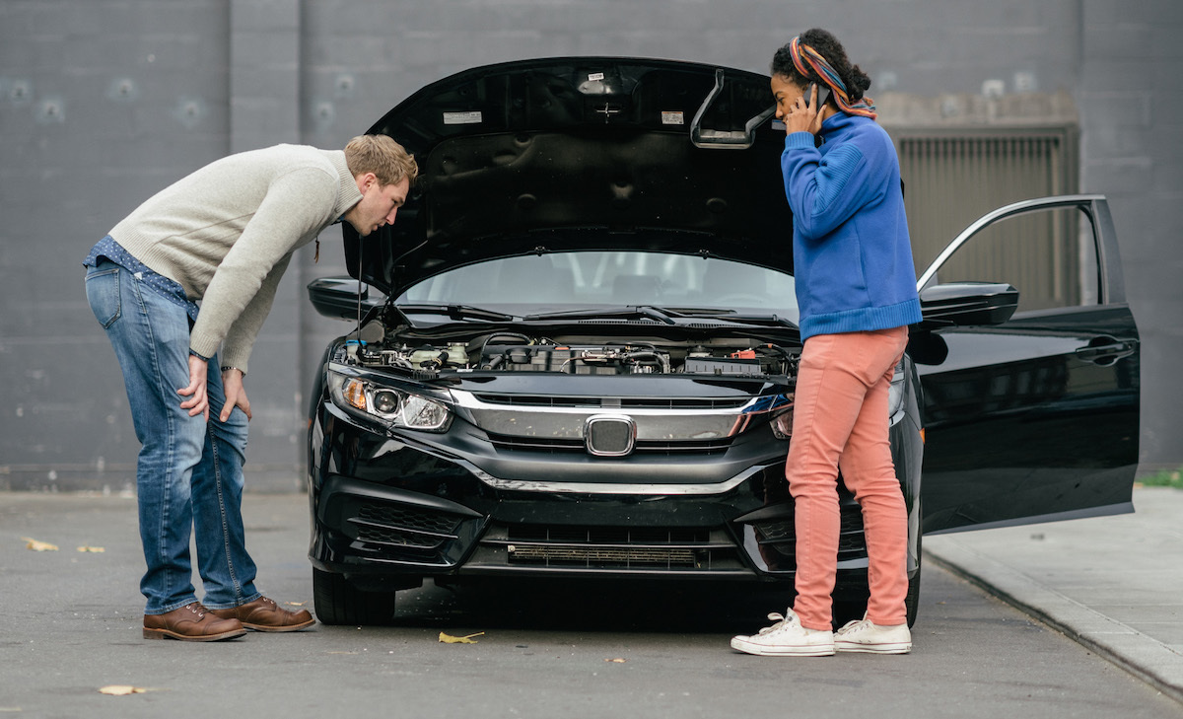
Under The Hood

Slide 19

Sentiment Analysis
<word form="great" wordnet_id="a-01278818" pos="JJ" sense="of major significance or importance" polarity="1.0" subjectivity="1.0" intensity="1.0" confidence="0.9" />
<word form="great" cornetto_synset_id="n_a-525317" wordnet_id="a-01123879" pos="JJ" sense="very good" polarity="1.0" subjectivity="1.0" intensity="1.0" confidence="0.9" />
<word form="great" wordnet_id="a-01386883" pos="JJ" sense="relatively large in size or number or extent" polarity="0.4" subjectivity="0.2" intensity="1.0" confidence="0.9" />
<word form="great" wordnet_id="a-01677433" pos="JJ" sense="remarkable or out of the ordinary in degree or magnitude or effect" polarity="0.8" subjectivity="0.8" intensity="1.0" confidence="0.9" />
Polarity=(1+1+.4+.8)/4=0.8
TextBlob(“Great”).sentiment
Subjectivity=(1+1+.2+.8)/4=0.75
https://github.com/sloria/TextBlob/blob/eb08c120d364e908646731d60b4e4c6c1712ff63/textblob/en/en-sentiment.xml

Slide 20
Sentiment Analysis
Great
wordnet_id | Polarity | Subjectivity
a-01278818 | 1 | 1
a-01123879 | 1 | 1
a-01386883 | 0.4 | 0.2
a-01677433 | 0.8 | 0.8
Average | 0.8 | 0.75
TextBlob(“Great chicken”).sentiment
Chicken
wordnet_id | Polarity | Subjectivity
a-00265314 | -0.5 | 0.9
a-00265314 | -0.7 | 1
Average | -0.6 | 0.95
Polarity=(0.8-0.6)/2=0.1
Subjectivity=(0.75+0.95)/2=0.85

Slide 21
Sentiment Analysis
Great
wordnet_id | Polarity | Subjectivity
a-01278818 | 1 | 1
a-01123879 | 1 | 1
a-01386883 | 0.4 | 0.2
a-01677433 | 0.8 | 0.8
Average | 0.8 | 0.75
Not + …
Polarity x (-0.5)
Subjectivity x 1
TextBlob(“Not Great chicken”).sentiment
Polarity=(0.8x(-0.5)-0.6)/2=-0.5
Subjectivity=(0.75+0.95)/2=0.85
Chicken
wordnet_id | Polarity | Subjectivity
a-00265314 | -0.5 | 0.9
a-00265314 | -0.7 | 1
Average | -0.6 | 0.95
Polarity=(0.8-0.6x(-0.5))/2=0.55
Subjectivity=(0.75+0.95)/2=0.85
TextBlob(“Great Not chicken”).sentiment

Slide 22
Sentiment Analysis
Great
wordnet_id | Polarity | Subjectivity
a-01278818 | 1 | 1
a-01123879 | 1 | 1
a-01386883 | 0.4 | 0.2
a-01677433 | 0.8 | 0.8
Average | 0.8 | 0.75
Very + …
Polarity x 1.3
Subjectivity x 1.3
Max=1
Polarity=(0.8x1.3 - 0.6)/2= 0.2
Subjectivity=(0.75x1.3+0.95)/2= 0.9625
TextBlob(“Very Great chicken”).sentiment
Chicken
wordnet_id | Polarity | Subjectivity
a-00265314 | -0.5 | 0.9
a-00265314 | -0.7 | 1
Average | -0.6 | 0.95
Polarity=(0.8-0.6x1.3)/2=0.01
Subjectivity=(0.75+0.95x1.3)/2=0.875
TextBlob(“Great very chicken”).sentiment
Max=1

Slide 23
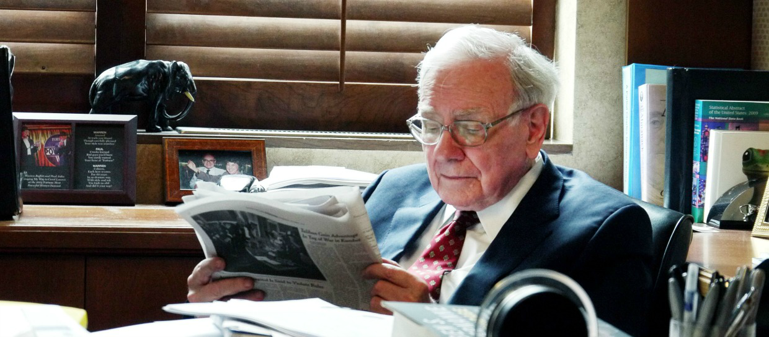
Stock Market Prediction

Slide 24
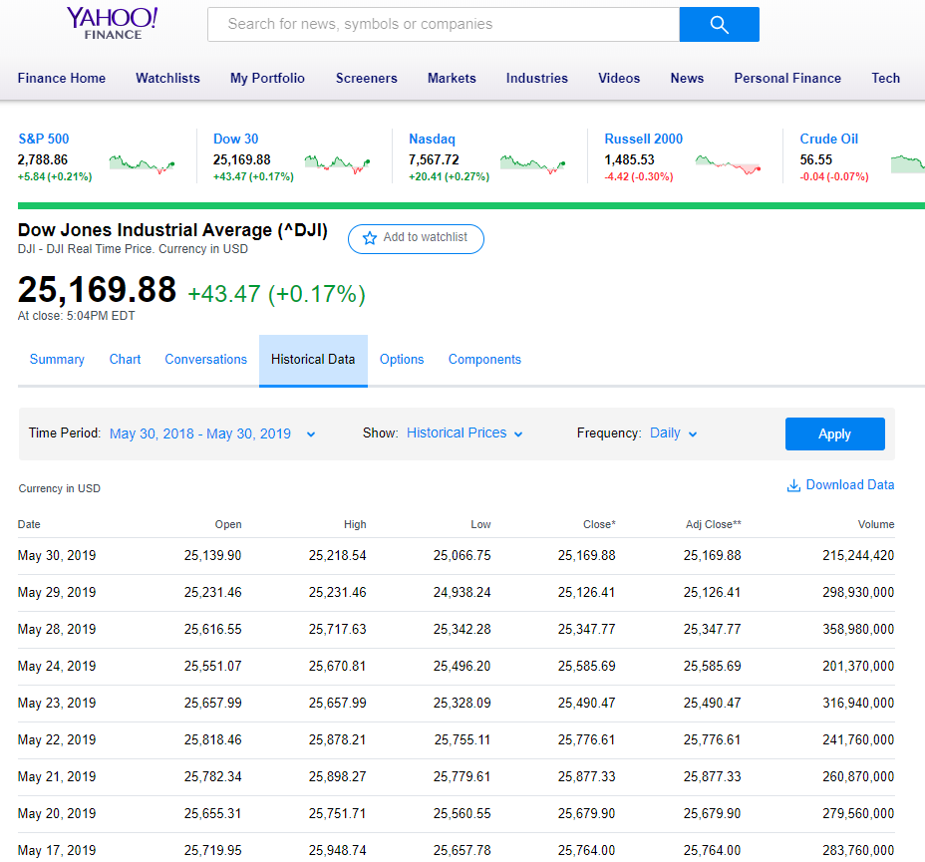

Yahoo Finance + Reddit Dataset
Dow Jones Industrial Average (DJIA)
Reddit

Slide 25
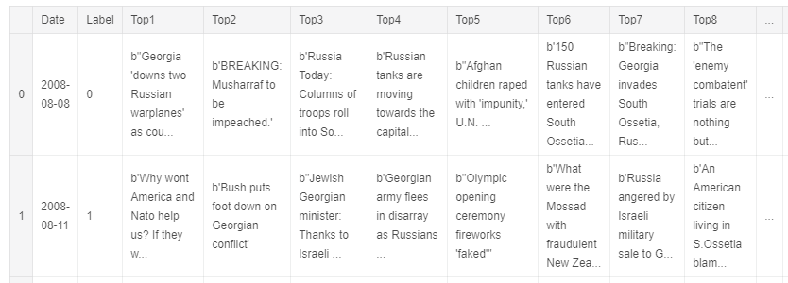
Corpus or Document Term Matrix
Daily records from:
2008-08-08 to 2016-07-01
Label 1: if the DJIA stayed the same or rose
Label 0: if the DJIA fell that day
Daily top 25 headlines from Reddit
[Ref] Sun, J. (2016, August). Daily News for Stock Market Prediction, Version 1. https://www.kaggle.com/aaron7sun/stocknews.

Slide 26


Love to share my experiences!
www.linkedin.com/in/mesmalif
Mohammad Esmalifalak, PhD

